Slide 1


Computer Network Basics of Network
Lecture# 1
Week #1
Components of Data Communication
Data Communication characteristics,
Data Representation
Data Communications and Networking, Fourth Edition, Behrouz A. Forouzan

Slide 2
Course Overview
Name of Course: Computer Networks
Credit Hours: 4(3-1)
No. of Lectures per week: 3 (Duration 1hr)
1 Lab per week (Duration 2 Hr)
Mid Exams:
Final Exams:

Slide 3
Marks Distribution
Internal Assessment: 35 Marks
Mid Semester Examination: 25 Marks
Final Semester Examination: 40 Marks

Slide 4
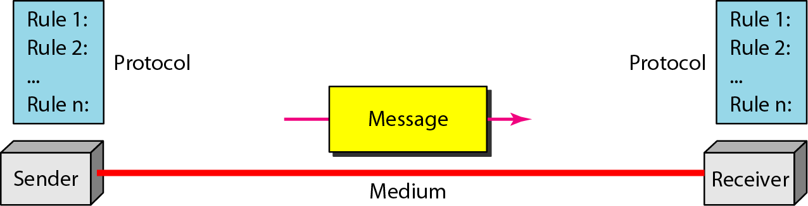
Data Communication
Data Communication is the exchange of data between two devices via some form of transmission

Slide 5
Components of Data Communication
Message: Data
Sender: The device that send the message
Receiver: The device that receive the message
Transmission Medium: The physical path between sender and receiver, the message travel.
Protocol: Protocol is a set of rules that governs data communication.

Slide 6
Message: The message is the information (data) to be communicated. Popular forms of information include text, numbers, pictures, audio, and video.
Sender: The sender is the device that sends the data message. It can be a computer, workstation, telephone handset, video camera, and so on.

Slide 7
Receiver: The receiver is the device that receives the message. It can be a computer, workstation, telephone handset, television, and so on.
Transmission Medium: The transmission medium is the physical path by which a message travels from sender to receiver. Some examples of transmission media include twisted-pair wire, coaxial cable, fiber-optic cable, and radio waves.

Slide 8
Protocol
A protocol is a set of rules that govern data communications.
Real-Life Example (Human):
Traffic signals 🚦 Everyone follows the same rules:
Red → Stop
Green → Go
If no rules, accidents happen. Same with computers.
WhatsApp chatting:
One phone sends message
Other phone receives
Both follow WhatsApp communication rules (protocol)

Slide 9
Data Communication characteristics
The effectiveness of a data communications system depends on four fundamental characteristics:
DELIVERY
ACCURACY
TIMELINESS
JITTER

Slide 10
Effectiveness of a data
Delivery:
Data must be delivered to the correct destination.
Example:
You send an email to Ali
If the email is delivered to Ahmed, delivery has failed ❌
If it reaches Ali, delivery is successful ✔️
Accuracy:
The received data must be exactly the same as the sent data
Example:
You transfer $500 online
If the receiver gets $500, the data is accurate ✔️
If the receiver gets $50, accuracy is lost ❌

Slide 11
Effectiveness of a data(Cont.)
Timeliness:
Data must be delivered on time.
Example:
In a live online lecture, voice and video should be received instantly
If the video comes late, the lecture becomes difficult to understand ❌
Jitter:
Data arrives at uneven intervals (sometimes fast, sometimes slow).
Example:
During a voice or video call:
Sound breaks
Video freezes
Words are cut
Jitter is especially important for real-time communication like voice/video calls and streaming.

Slide 12

Data Representation
Data representation is the method of converting different types of information into a form that a computer can understand, store, process, and transmit (usually in binary form: 0s and 1s).
Information today comes in different forms such as text, numbers, images, audio, and video.

Slide 13
Text
In data communications, text is represented as a bit pattern, a sequence of bits (Os or Is).
Representation: Characters are represented using codes like ASCII or Unicode.
Example:
The letter A → ASCII code 65 → Binary 01000001
Text like emails, documents, messages

Slide 14
Numbers
Numbers are also represented by bit patterns.
Representation: Numbers are represented in binary, decimal, or floating-point format.
Example:
Number 5 → Binary 101
Marks, prices, calculations

Slide 15
Images
Images are also represented by bit patterns.
In its simplest form, an image is composed of a matrix of pixels, where each pixel is a small dot.
Each pixel has a color value.
Example:
A photo made of thousands of pixels
Each pixel color is represented in binary (RGB values)

Slide 16
Audio
Audio refers to the recording or broadcasting of sound or music. Audio is by nature different from text, numbers, or images. It is continuous.
Example:
Voice notes, songs
Sound converted into digital form using sampling

Slide 17
Video
Video refers to the recording or broadcasting of a picture or movie.
Video can either be produced as a continuous entity (e.g., by a TV camera), or it can be a combination of images, each a discrete entity, arranged to convey the idea of motion.
Representation: Video is a sequence of images (frames) with audio.
Example:
YouTube videos
Online lectures, movies

Slide 18
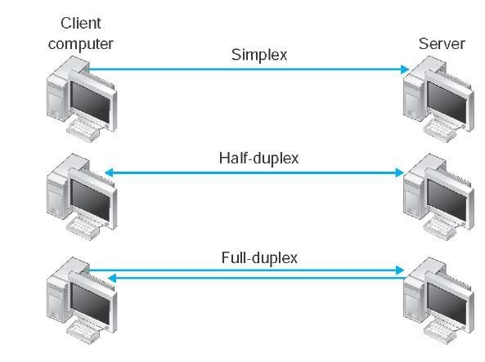
Data Flow in Communication
Data flow communication describes the direction in which data moves between two devices. There are three main types: Simplex, Half-Duplex, and Full-Duplex.

Slide 19
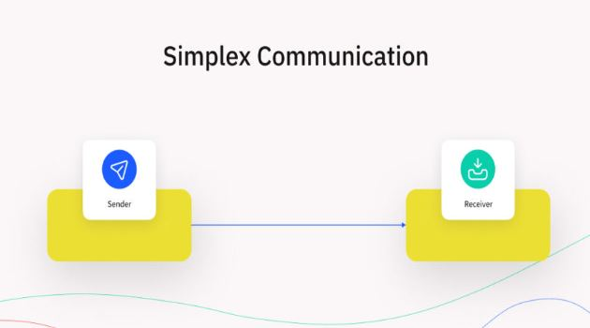
Simplex
Definition:
Data flows in only one direction.
One device sends, and the other device receives, but the receiver cannot send back.
Example:
Keyboard → Computer: Keyboard sends data, computer receives it. Keyboard cannot get data back from computer.
TV Broadcast: TV station sends signals, TVs receive. TVs cannot send signals back.
Key Point: One-way communication only.

Slide 20
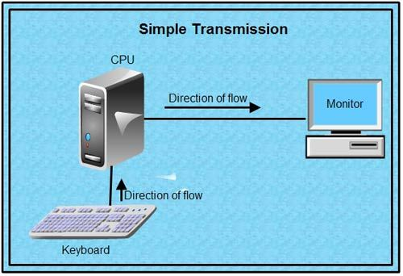

Slide 21
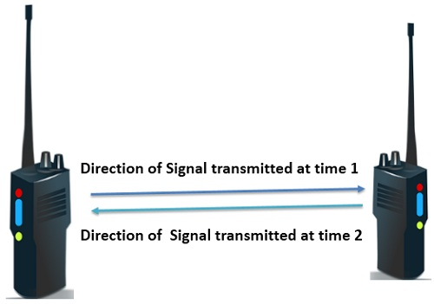
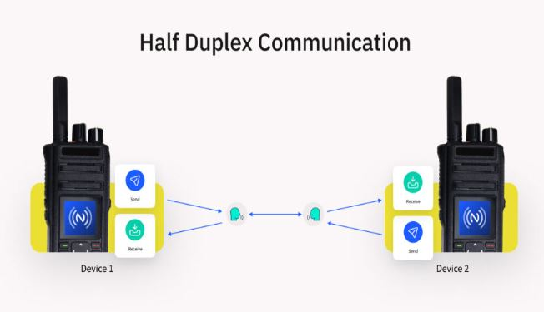
Half-Duplex
Definition:
Data flows in both directions, but only one device can send at a time.
When one device sends, the other must wait to respond.
Example:
Walkie-Talkie: You press the button to speak, the other person listens. Then the other person presses the button to reply.
Key Point: Two-way communication, not simultaneous.

Slide 22
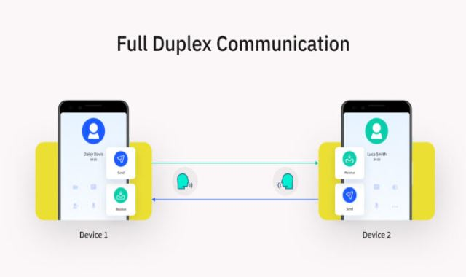
Full-Duplex Mode
Definition:
Data flows in both directions simultaneously.
Both devices can send and receive at the same time.
Take telephone as an example, people at both ends of a call can speak and be heard by each other at the same time.

Slide 23
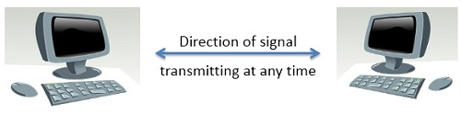

Example

Slide 24
THANK YOU
You can Find me:
mehakrana.CS@tuf.edu.pk

